Slide 1
Temporal Disaggregation Using Multivariate STSM
by Gian Luigi Mazzi &
Giovanni Savio
Eurostat - Unit C6
Economic Indicators for the Euro Zone

Slide 2
Scheme
Introduction and objectives: why a multivariate approach to time disaggregation and which gains from it?
SUTSE models and comparisons with previous literature
Results of comparisons using OECD data-set
Conclusions

Slide 3
Introduction and objectives (1)
Aims of a temporal disaggregation methods:
(a) interpolation, distribution and extrapolation of time series; (b) use for all frequency combinations; (c) use for both raw and seasonally adjusted series; (from d to z) other properties
Classical approaches: direct and indirect methods
Indirect ‘classical’ methods are univariate: the supposed independent series is/are not modeled
Instead in the multivariate approach all series are modeled: this has both theoretical and practical advantages …

Slide 4
Why a multivariate approach? (1)
Standard univariate approaches consider the general linear model:
The approaches differ as far as concerns the structure of residuals . These can be:
    WN or ARIMA(1,0,0) for Chow-Lin
    ARIMA(0,1,0) for Fernandez
    ARIMA(1,1,0) for Litterman
    ARIMA(p,d,q) for Stram-Wei

Slide 5
Why a multivariate approach? (2)
The hypotheses underlying these approaches are:
    Weak exogeneity of indicator(s)
    Existence of a behavioral relation between the target series and the indicator(s)
    (Implicit) Absence of co-integration
None of assumptions 1. and 2. is necessarily fulfilled in current practices!
The lack of weak exogeneity makes estimates not fully efficient. Fully efficient estimates can be obtained from the univariate approaches only under very special conditions

Slide 6
Why a multivariate approach? (3)
The system does not co-integrate for some approaches; in other cases, an AR component implies mis-specification and/or that common factors are not taken into account
The existence of a behavioural (cause-effect) relation is not true in many applications (ex. disaggregation of Value added in industry through Industrial production index)
The general situation is one in which: 1. the series are affected by the same environment; 2. move together in the short-long run; 3. measure similar things; 4. but none causes necessarily the other in economic/statistic terms

Slide 7
SUTSE models (1)
The suggested SUTSE approach has these features:
  Uses STSM which are directly expressed in terms of components of interest
  Temporal disaggregation is considered as a missing observation problem
  Uses the KF to obtain the unknown values
  Allows for: a) disaggregation; b) seasonal adjustment; c) trend-cycle estimation
  Common component restrictions can be tested and imposed quite naturally
  Can be applied for almost any practical problem of time disaggregation

Slide 8
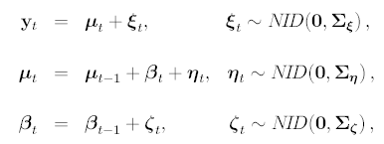
SUTSE models (2)
The general form of the SUTSE model is the LLT:
Restrictions can arise in the ranks (co-integration) and/or in proportionalities (homogeneity) of the covariance matrices

Slide 9


SUTSE models (3*)
The LLT model is put in SSF as:
where:

Slide 10
SUTSE models (4*)
SUTSE models are estimated in the TD using KF, which yields the one-step ahead prediction errors and the Gaussian log-LK via the PED
Numerical optimization routines are used to maximize the log-LK with respect to the unknown parameters determining the system matrices
The estimated parameters can be used for forecasting, diagnostics, and smoothing
Backward recursions given by the smoothing yield optimal estimates of the unobserved components

Slide 11
SUTSE models (5*)
Interpolation and distribution find an optimal solution in the KF framework where they are treated as missing observation problems
One has simply to adjust the dimensions of the system matrices, which become time-varying, and introduce a cumulator variable in the distribution case, where the model and the observed timing intervals are different
The KFS is run by skipping the updating equations without implications for the PED

Slide 12
Comparison SUTSE-Classical approaches*
Under which conditions is the SUTSE approach identical to the classical approaches and, more important, when can we obtain efficient estimates from the univariate models?
The conditions are quite unrealistic
The LLT model has a reduced vectorial form IMA (2,2) and, in general, SUTSE models have MA but not AR components. Then we need a level with an autoregressive form
In general, in order to obtain fully efficient estimates we have to impose either homogeneity (with known proportionality coefficient) or zero (diffuse or weak) restrictions on variances-covariances
Further, the autoregressive coefficient, if any, should be the same for all the series

Slide 13
Results of comparisons (1)
Data-set drawn from MEI
Twelve biggest Oecd countries and eight sets of data
1) Industrial production index vs. Deliveries in manufacturing (D-QM)
2) GDP vs. Industrial production index (D-YQ)
3) Consumer vs. Producer price indices (D-QM)
4) Private consumption vs. GDP (D-YQ)
5) GDP deflator vs. Consumer price index (D-YQ)
6) Broad vs. Narrow money supply (I-QM)
7) Short-term vs. Long-term interest rates (D-YM)
8) Imports f.o.b. vs. Imports c.i.f. (D-YQ)

Slide 14
Results of comparisons (2)
We consider the relative performance of different temporal disaggregation methods (with and without related series)
The estimated results are compared with true data using RMSPE statistics (results are similar with other methods)
Ox program and SsfPack package are used for SUTSE models, Ecotrim for all other methods
The SUTSE approach has also been implemented under Gauss

Slide 15
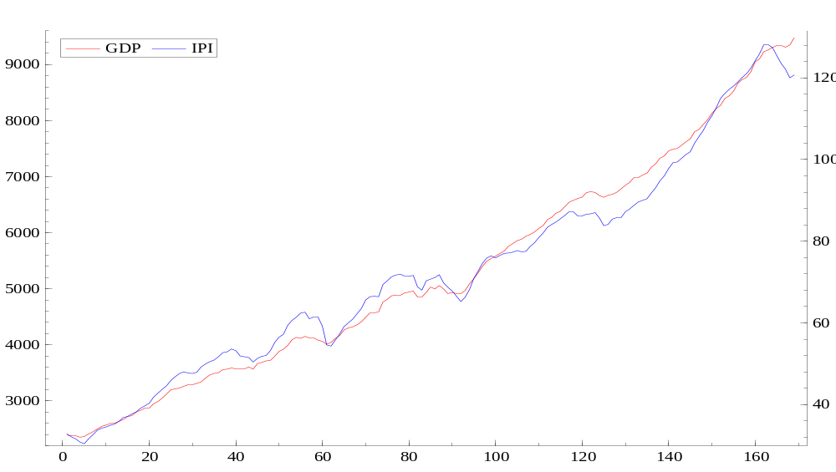
Results of comparisons (3)

Slide 16


Results of comparisons (4)
Series are defined over the sample 1960q1-2002.1. The estimates with a LLT model are:
Results give a RMSPE equal to 0.355, the existence of a common slope and an irregular close to zero. Imposing such restrictions does not add to the fit
The USM model gives a RMSPE of 0.465
Including a cycle gives
with a RMSPE equal to 0.351

Slide 17
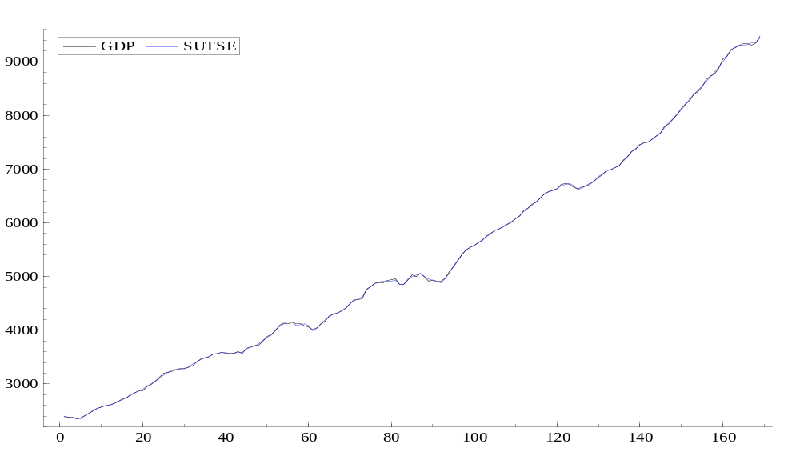
Results of comparisons (5)

Slide 18
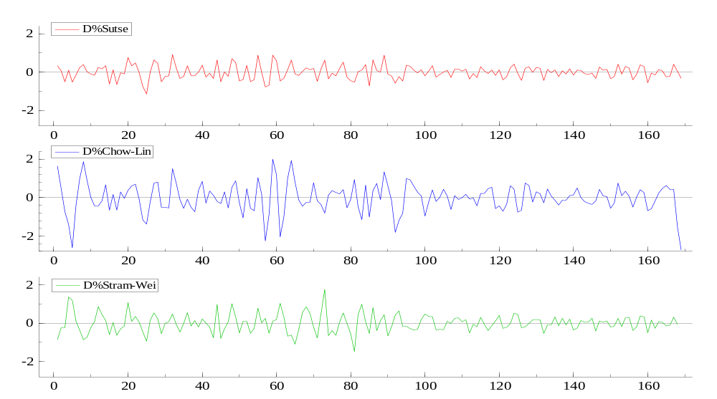
Results of comparisons (6)

Slide 19
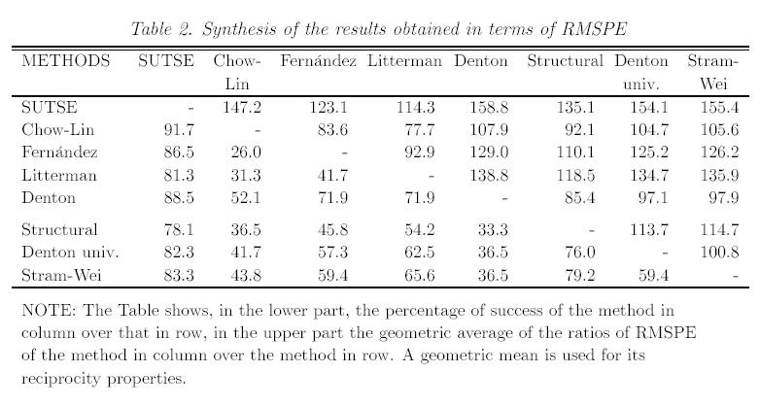
Results of comparisons (7)

Slide 20
Conclusions
The SUTSE approach does not impose any particular structure on the data: one starts from the LLT model and let the system itself ‘impose’ the restrictions. Estimates are obtained in a ‘model-based’ framework
The univariate/multivariate structural approach gives substantial gains over competitors, with a probability success of 75%-90% and gains of 15%-60%
Researches in this field are:
  Use of logarithmic transformations
  Tests for the form of the SUTSE model and the seasonal component
  Extensions of its use to ‘real life’ cases

